Slide 1
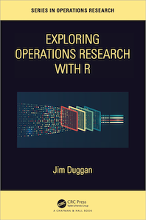
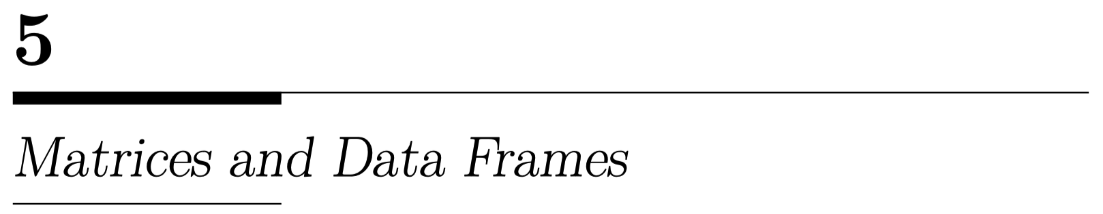

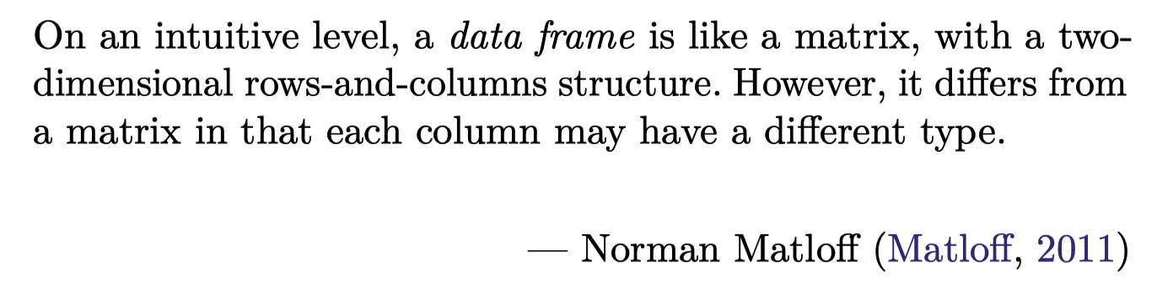
https://github.com/JimDuggan/explore_or

Slide 2
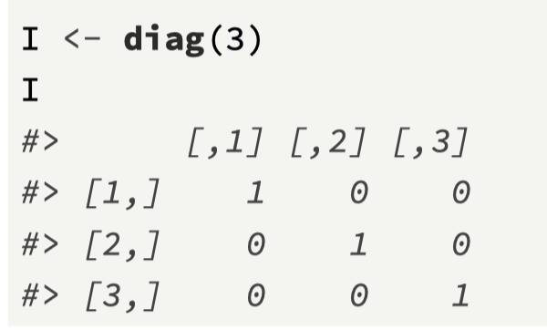
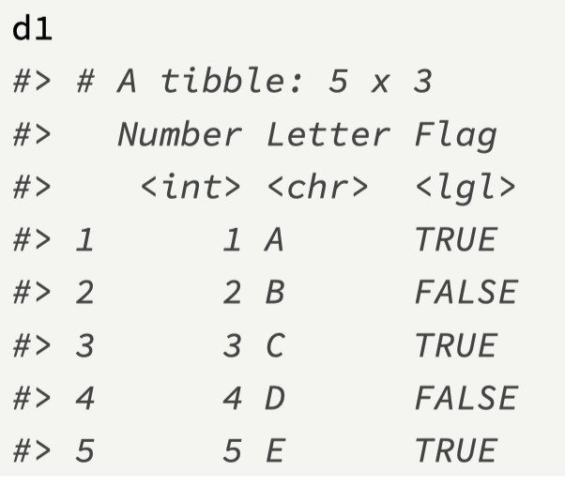
Overview
To date, we have used atomic vectors and lists to store information.
While these are foundational data structures in R, they do not provide support for processing rectangular data, which is a common format in data science.
Rectangular data, as the name suggests, is the usual format used in spreadsheets or databases, and it comprises rows of data for one or more variables
In R, the Matrix and Data Frame (or Tibble) can be used to store two-dimensional data.

Slide 3
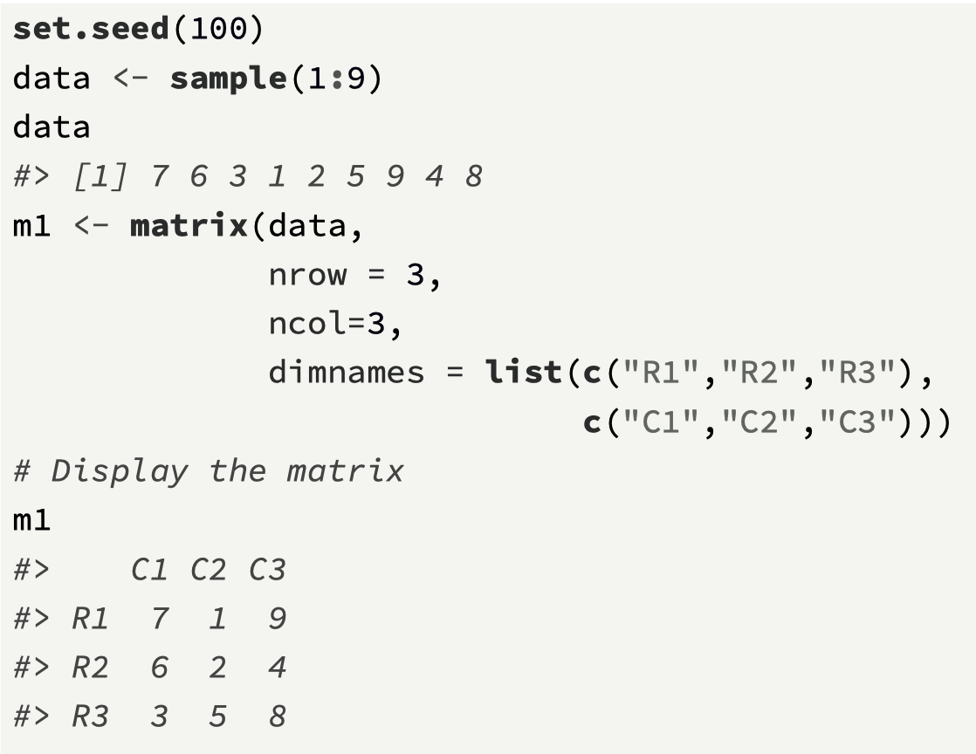
matrix
In R, a matrix is a two-dimensional structure, with rows and columns, that contains the same type.
A simple way to understand a matrix is that it is an atomic vector in two dimensions, and is created using the matrix() function, with the following arguments:
data, which are the initial values, contained in an atomic vector, supplied to the matrix,
nrow, the desired number of rows,
ncol, the desired number of columns,
byrow, a logical value (default is FALSE), that specifies what way to fill the matrix with data, either filled by row or by column,
dimnames, a list of length 2 giving row and column names, respectively.

Slide 4
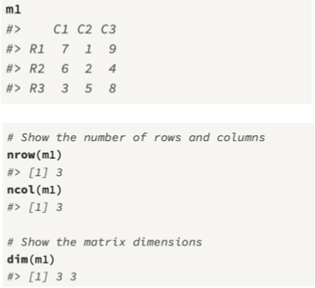
Additional points
The matrix is populated by column order as the default. If by_row was set to TRUE, then the matrix would be populated by row order.
The row and column names are set using the dimnames argument. This is not required, and row names and column names can always be set on a matrix using the functions rownames() and colnames().
The functions nrow() and ncol() can be used to return the matrix dimensions.
The function dim() provides information on the matrix dimensions, and can also be used to resize a matrix, for example, converting a 3 × 3 to a 1 × 9.

Slide 5
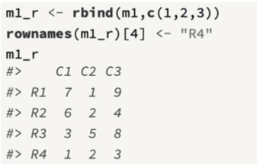
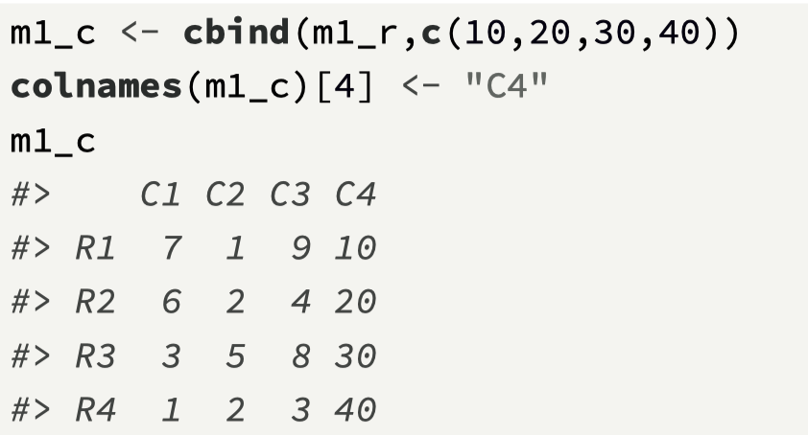
Adding rows with rbind(), columns with cbind()

Slide 6
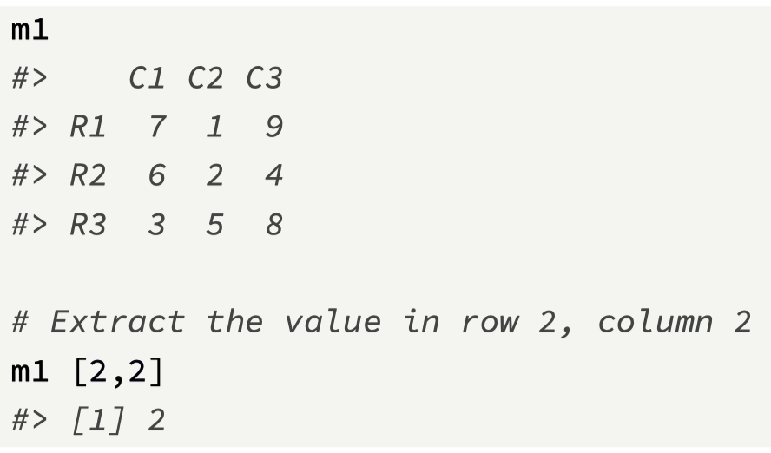
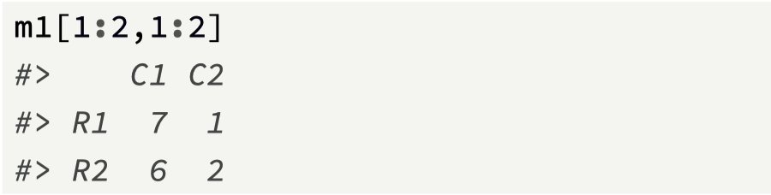
Subsetting a matrix
To subset a matrix, we supply an index for each dimension [row number, column number];
For example, here we extract the value contained in row 2, column 2.
The rules for atomic vector subsetting also apply.
Ranges can be used

Slide 7
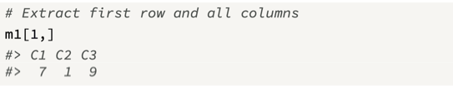
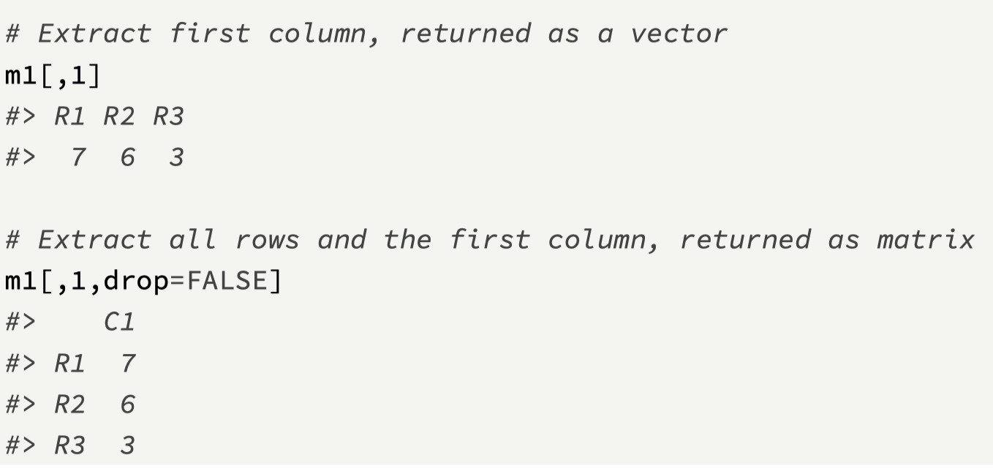
Blank subsetting
Blank subsetting for one of the dimensions lets you retain all of the rows, or all of the columns.
Note that if only one column is subsetted, R will return a vector by default.
To keep the matrix structure, the argument drop=FALSE is added.

Slide 8
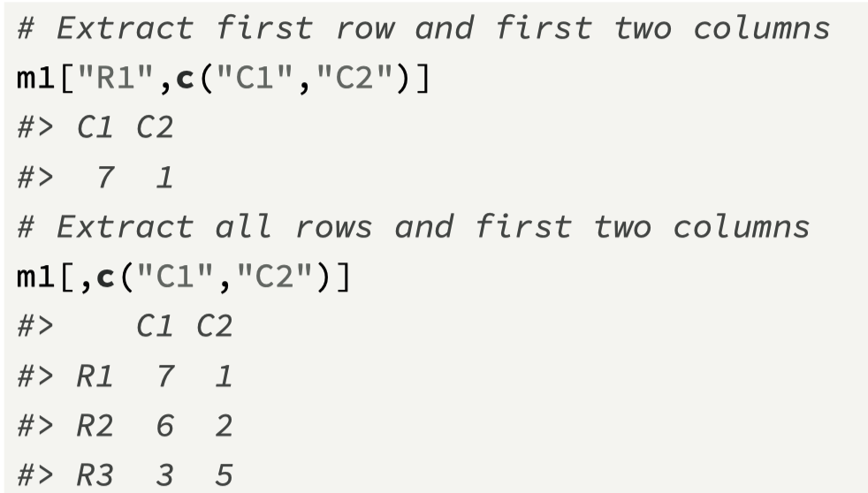
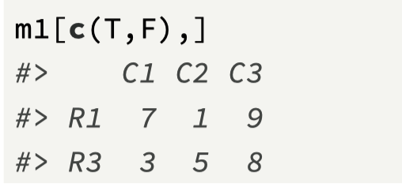
Using names and logical vectors to subset

Slide 9
Useful matrix functions
is.matrix() is used to test whether the object is a matrix or not
By default, matrix operations such as multiplication, division, exponentiation, addition, and subtraction are performed on an element-wise basis
There is a special operator %*% that is used for matrix multiplication
Use the function t() to obtain the transpose of a matrix.
The function dim() can be used to return the matrix dimensions, namely, the number of rows and the number of columns
The functions colSums(), colMeans(), rowSums() and rowMeans() can be used to generate summary statistics for a matrix.
The function dimnames() returns the row and column names in a list.
The functions rownames() and colnames() return the row names and column names as atomic vectors. It can be used to set names also.
The function diag() can be used in two ways. First, it can set all the diagonal elements of a matrix. Second, it can be used to create the identity matrix for a given dimension.
The function eigen() can be used for calculating the eigenvalues and eigenvectors
The determinant of a matrix is calculated using the function det()

Slide 10
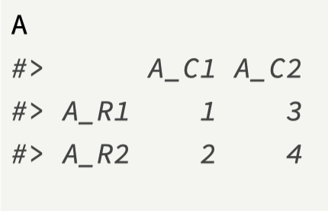
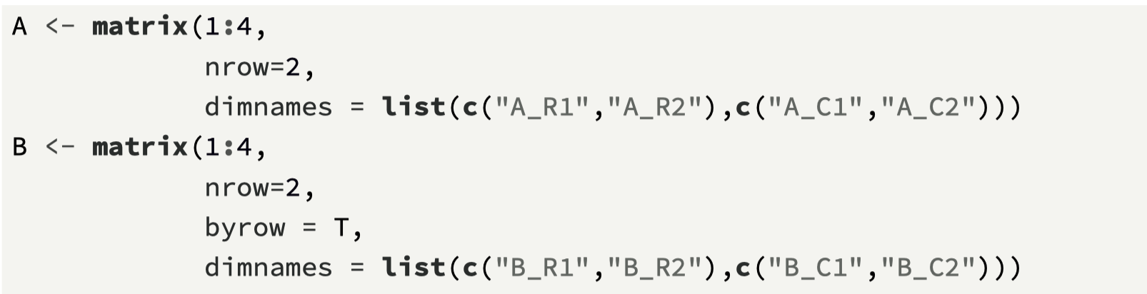
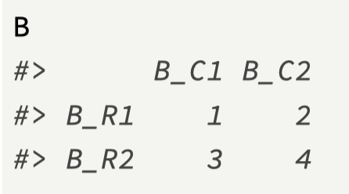
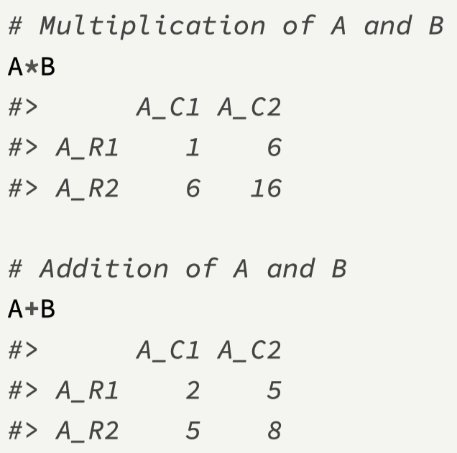
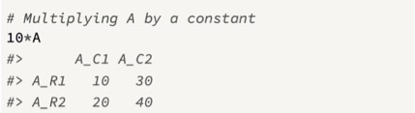
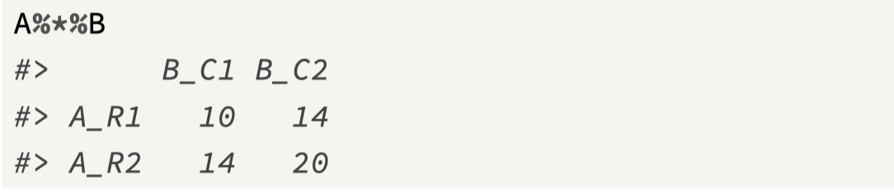
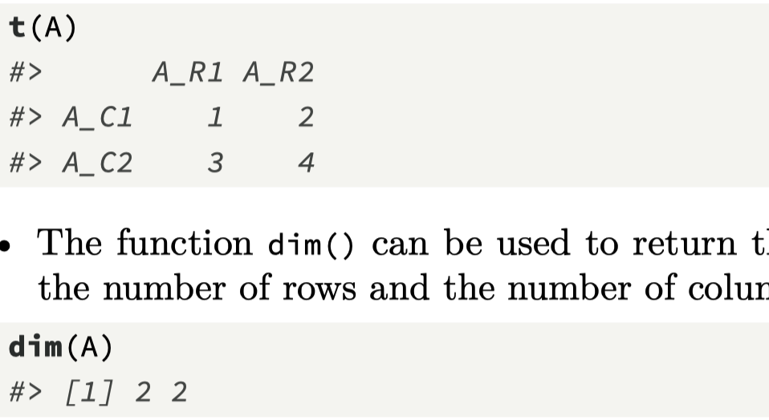

Slide 11
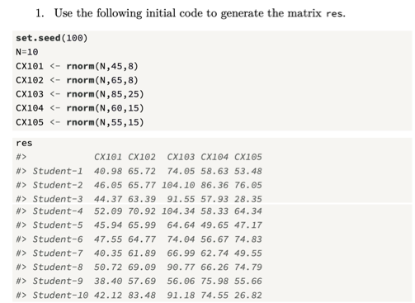
Challenge 5.1
Ensure that the row and column names are also added
Then add the following columns to res:
Mean Grade
Min Grade
Max Grade

Slide 12
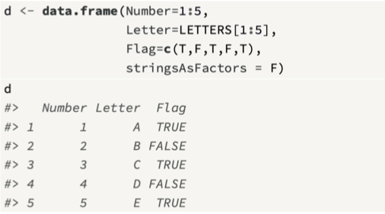
Data Frame
On an intuitive level, a data frame is similar to a matrix, with a two-dimensional row and column structure, while on a technical level, a data frame is a list, with the elements of that list containing equal length vectors.
Crucially, the elements (columns) of a data frame can be of different types, and this feature provides functionality for processing datasets as part of the operations research process.
The function data.frame() creates a data frame object

Slide 13
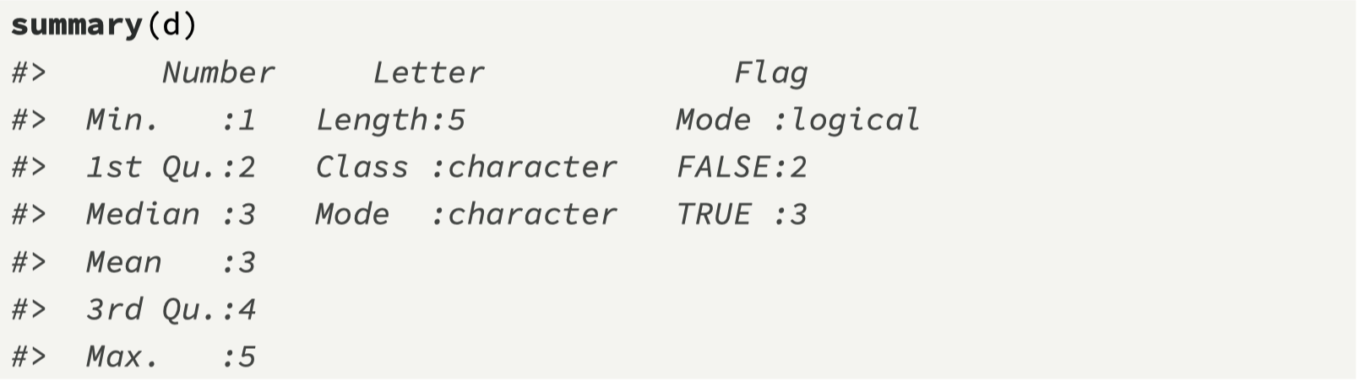
Using summary()

Slide 14
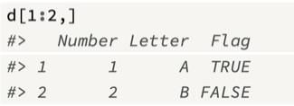
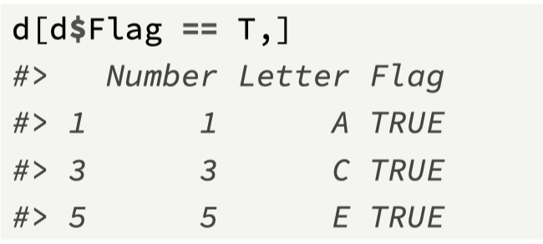
Subsetting from a Data Frame
An important activity that is required with a data frame is to be able to: (1) subset rows, (2) subset columns, and (3) add new columns.
Because a data frame is a list and also shares properties of a matrix, we can combine subsetting mechanisms from both of these data structures to subset a data frame.
This means we can use [ and $ for subsetting

Slide 15
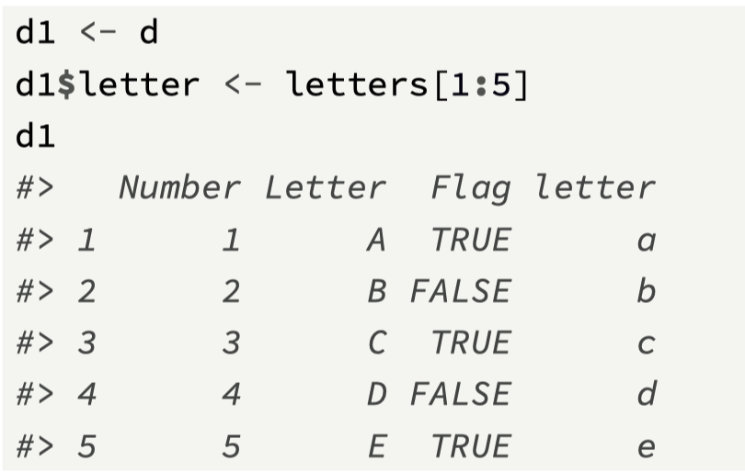
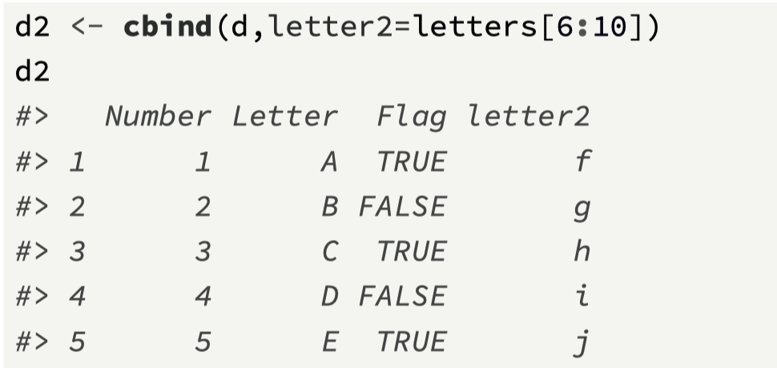
Adding columns to a Data Frame

Slide 16
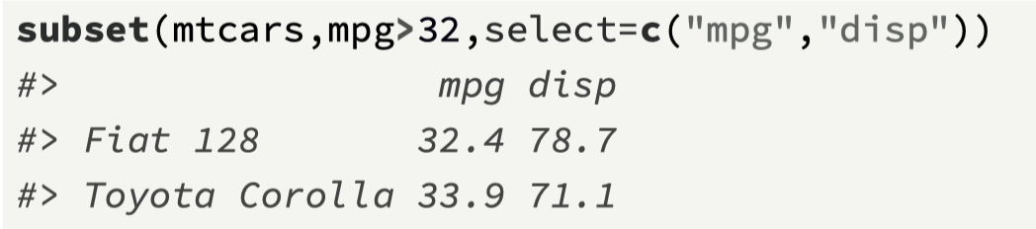
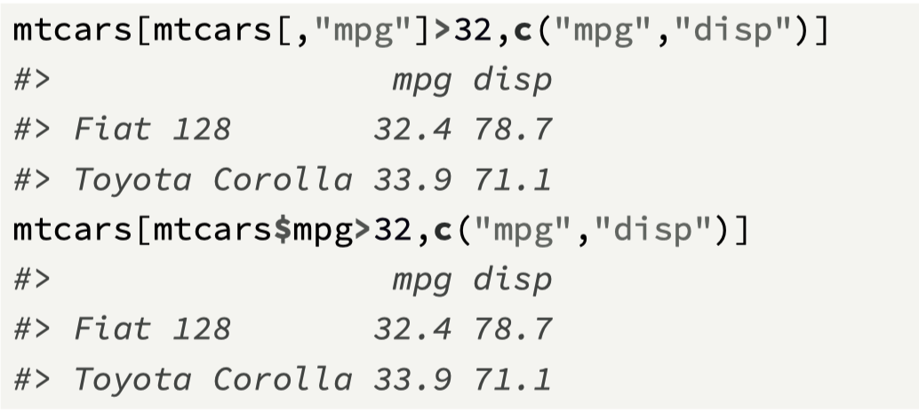
subset() to filter rows and columns
The function subset(x, subset,select) returns subsets of vectors, matrices, or data frames that meet specified conditions.
The main arguments to provide when subsetting data frames are:
x, the object to be subsetted,
subset, a logical expression indicating which rows should be kept
select, which indicates the columns to be selected from the data frame. If this is not present, all columns are returned.

Slide 17
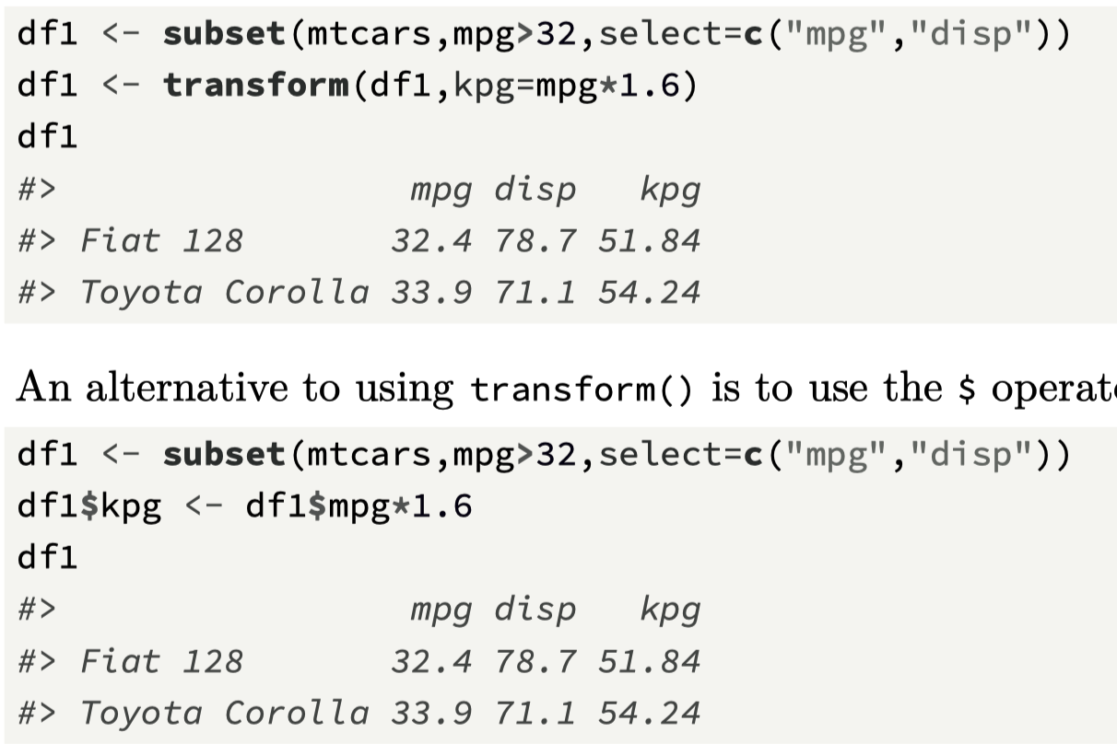
transform()
A second function that can be used to manipulate data frames is transform(data, ...), which takes in the following arguments:
data, which is the data frame,
..., which are additional arguments that capture the details of how the new column is created.

Slide 18
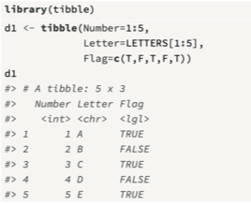
Tibbles
As we move through the book, we will rely more on tibbles than data frames.
Tibbles are a type of data frame; however they alter some data frame behaviors to make working with packages in the tidyverse easier.
There are two main differences when compared to the data.frame
Printing, where, by default, tibbles only show the first ten rows, and limit the visible columns to those that fit on the screen (the type is also shown)
Subsetting, where a tibble is always returned, and also partial matching are not supported
Include library(tibble) in your code

Slide 19
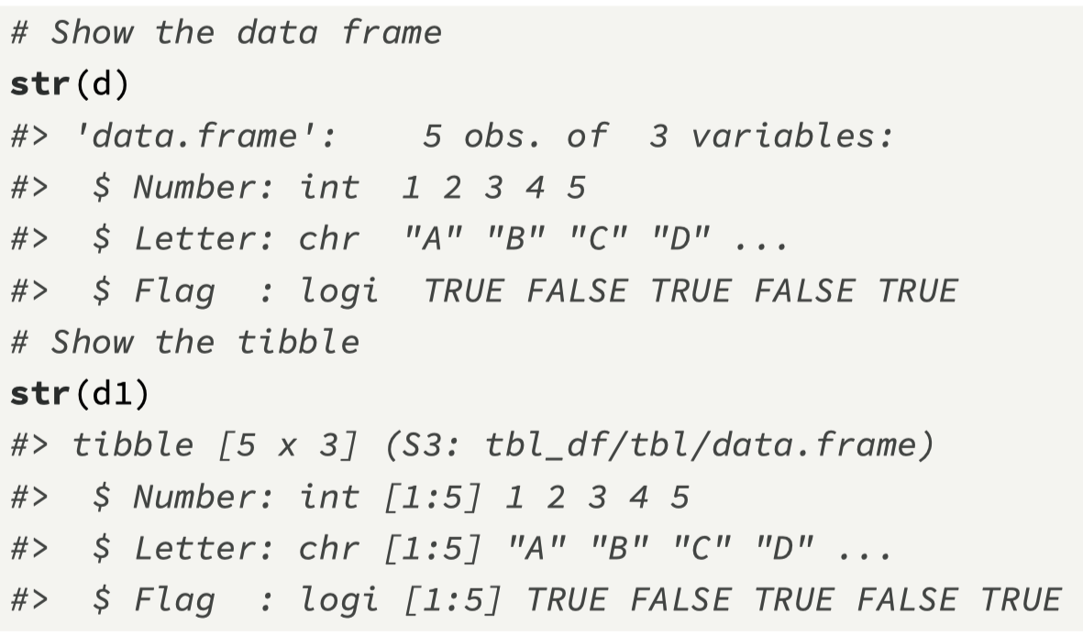
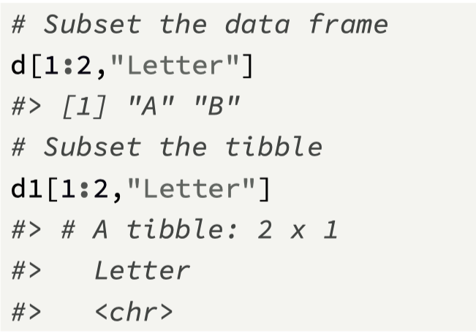
Differences between tibble and data.frame

Slide 20
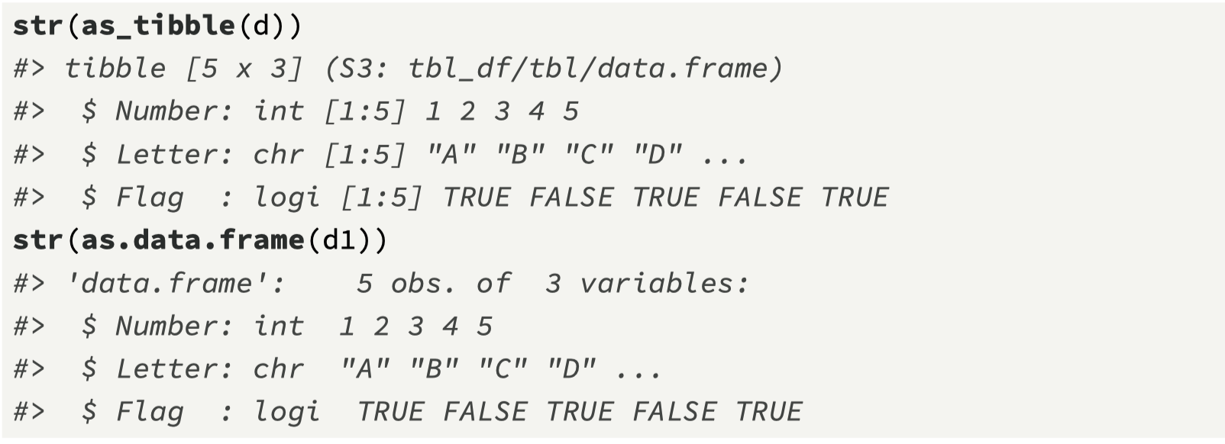
Converting between the two objects

Slide 21
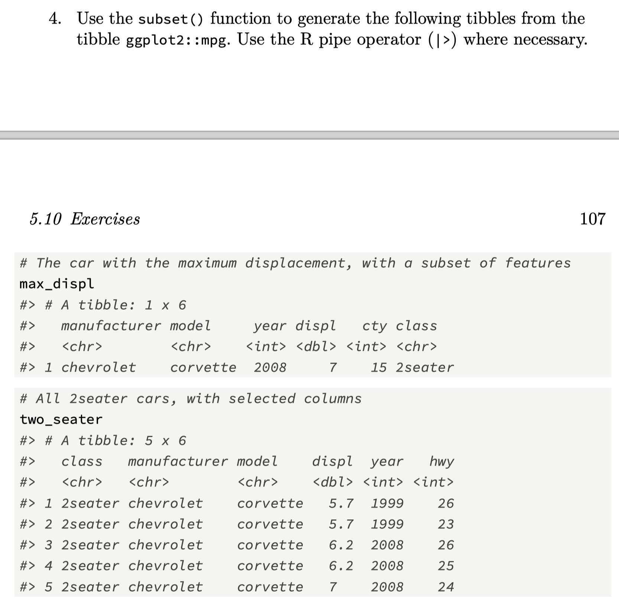
Challenge 5.2

Slide 22
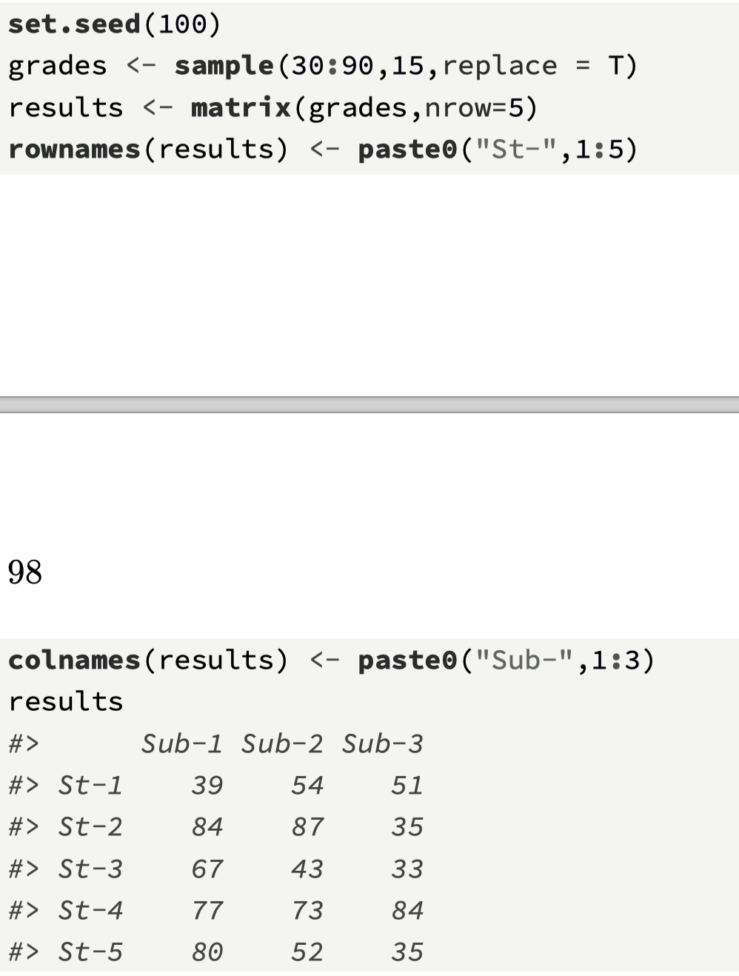
Functionals on matrices and data frame
The apply(x,margin,f) function is a functional used to iterate over matrices and data frames, and it accepts the following arguments:
x, which can be a matrix or a data frame.
margin, a number that indicates whether the iteration is by row (margin=1), or by column (margin=2).
f, which is the function to be applied during each iteration.

Slide 23
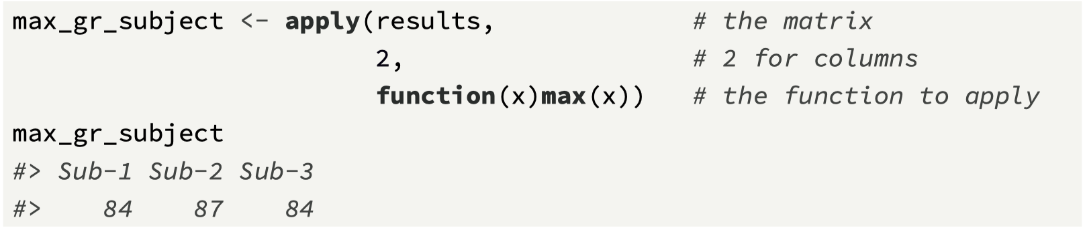
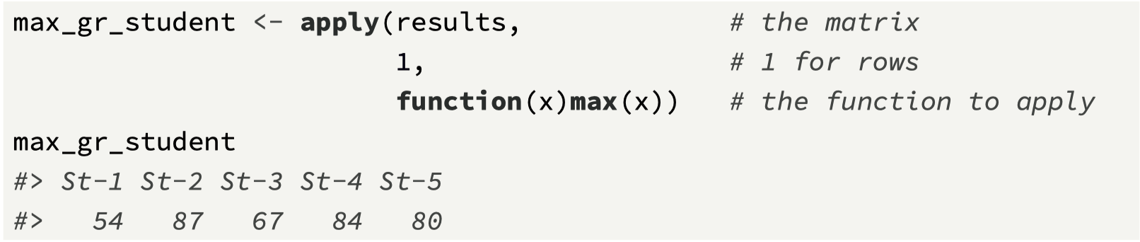
Using the apply() function

Slide 24
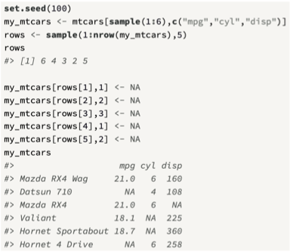
Processing data frames
The apply() function can also be used on data frames, again, to iterate and apply a function over either each row or column.
For example, if we take a subset of the data frame mtcars and insert some random NA values, we can then count the missing values by either row or column

Slide 25
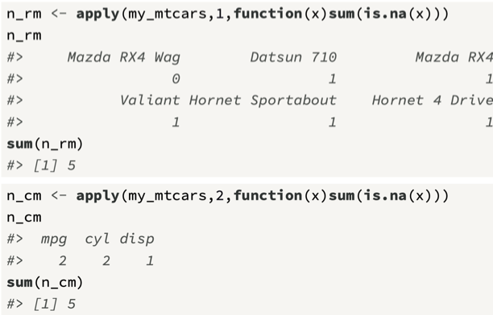
Count missing values by row, and column

Slide 26
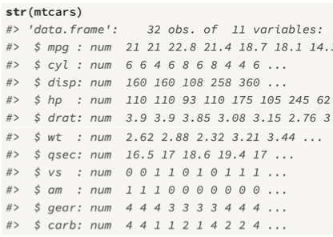
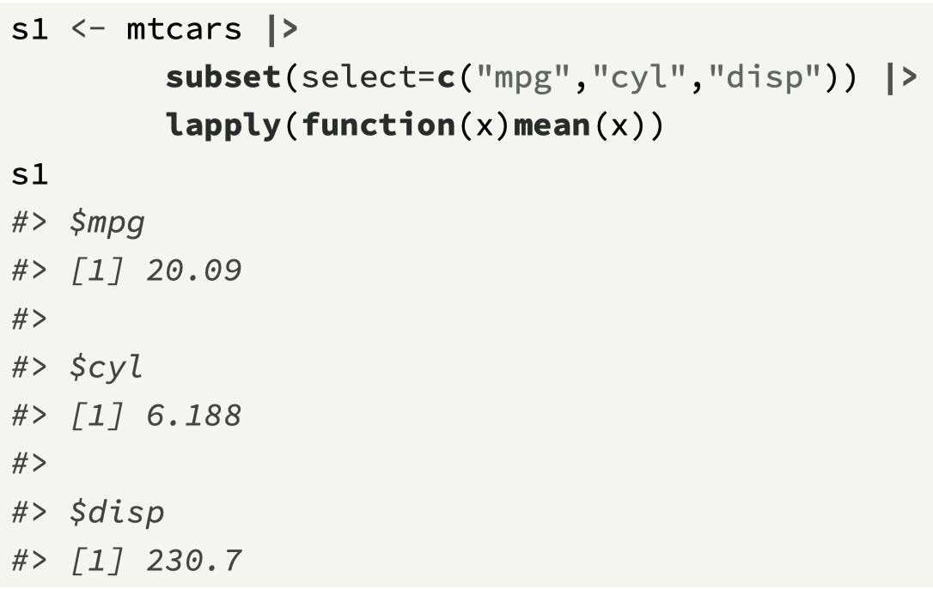
Getting means from mtcars data frame

Slide 27
Chapter 5 Recap
Matrix: creating, subsetting, and changing
Useful matrix functions
Data Frames: subsetting, changing, and adding columns
subset() and transform() functions
Tibbles: a modern Data Frame
apply(), a functional for rectangular data
Next Challenge: a pipeline with data frames
Next Topic: The S3 object system

Slide 28
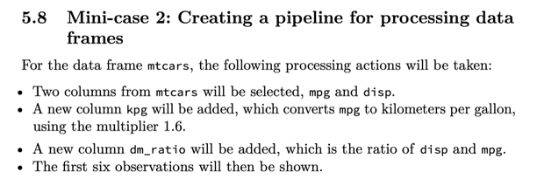
Challenge 5.3

